Slide 1
Choose the best hotel for you

Slide 2
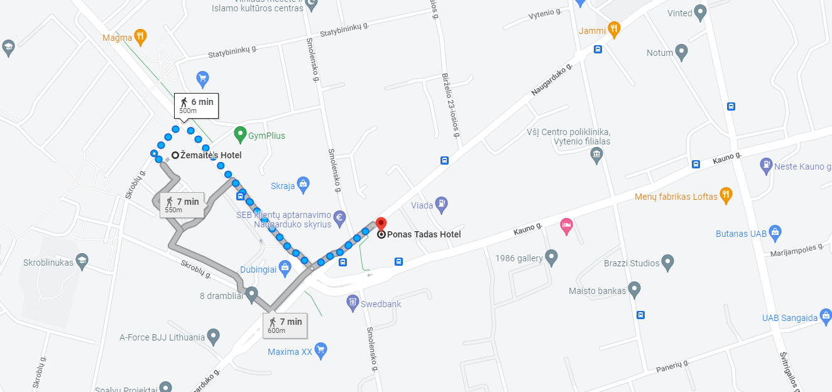
Zemaites Hotel
Adress: Zemaites str. 15
LT-03118 Vilnius, Lithuania
Phone:+370 5 213 31 93
Email: info@hotelzemaites.lt
Website: //www.hotelzemaites.lt/3-star-hotel-in-vilnius/

Slide 3
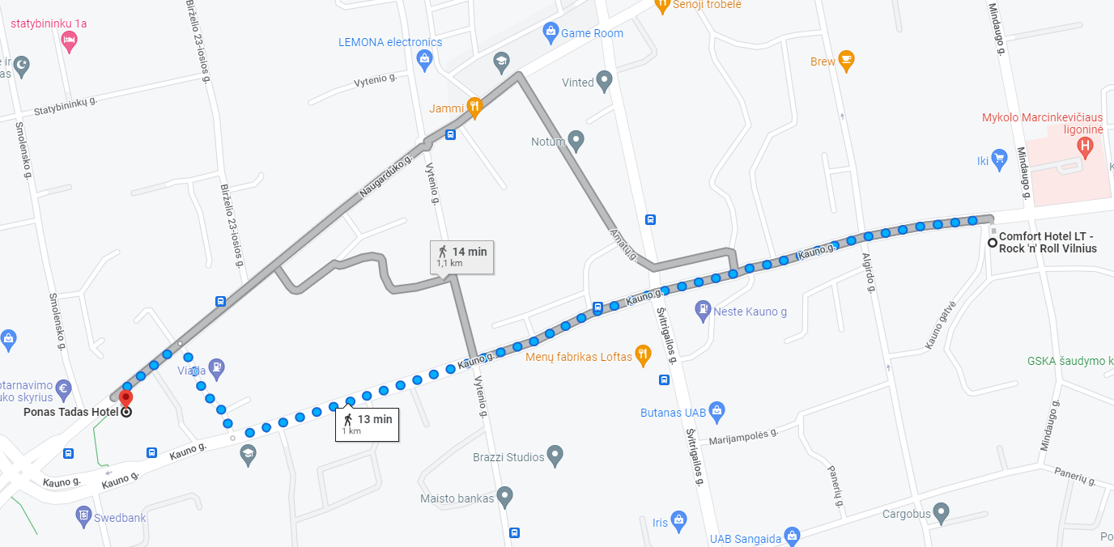
Comfort Hotel
Adress: Kauno str. 14
LT-03212 Vilnius Lithuania Tel.:+370 5 25 05 111 Fax.: +370 6 85 98 920 E-mail: Co.Vilnius@choice.lt
Website: https://comforthotel.lt/hotel-vilnius/

Slide 4
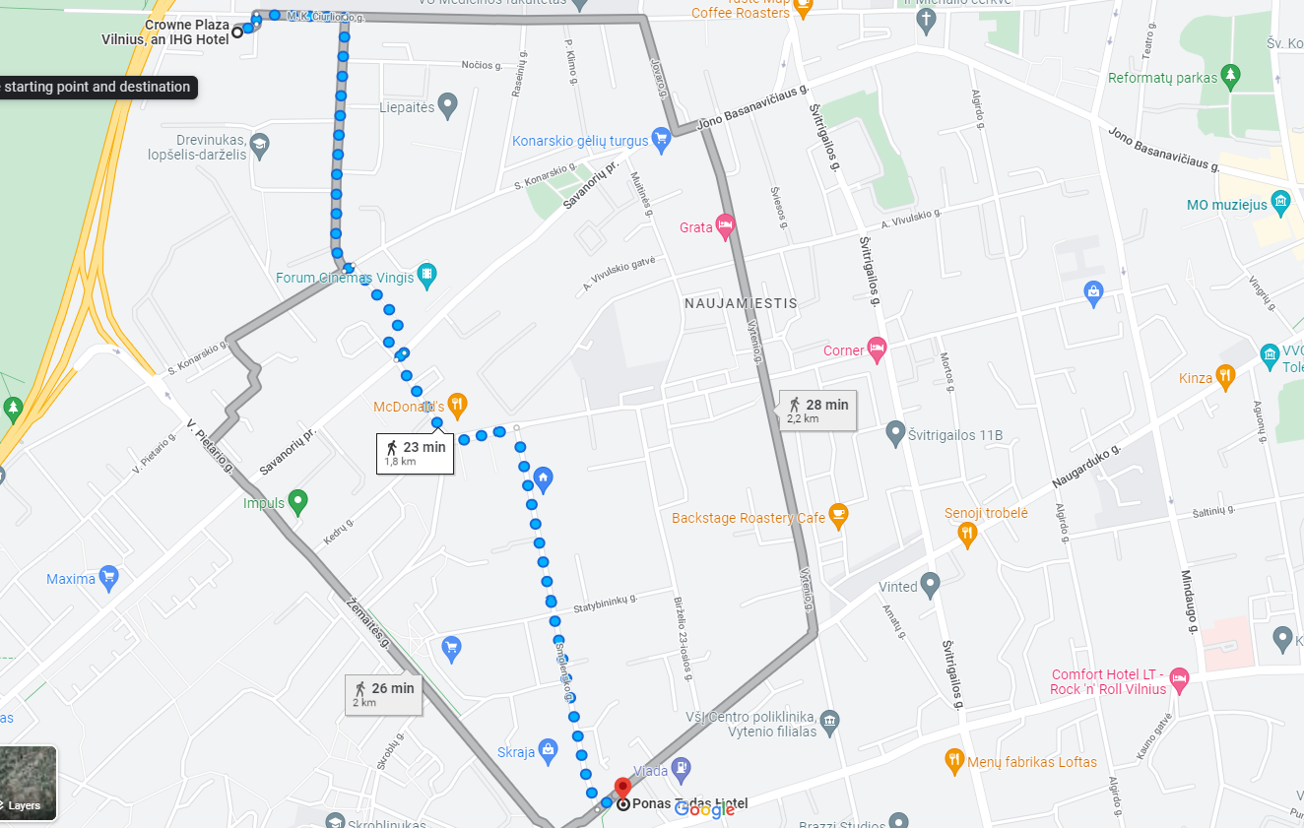
Crown Plaza Vilnius
Adress: Mk Ciurlionio Street 84 Vilnius LT-03100
Lithuania+ 370-5-2743400
Website: https://www.ihg.com/crowneplaza/hotels/gb/en/vilnius/vnoci/hoteldetail?cm_mmc=YextLocal-_-CP-_-LT-_-VNOCI

Slide 5
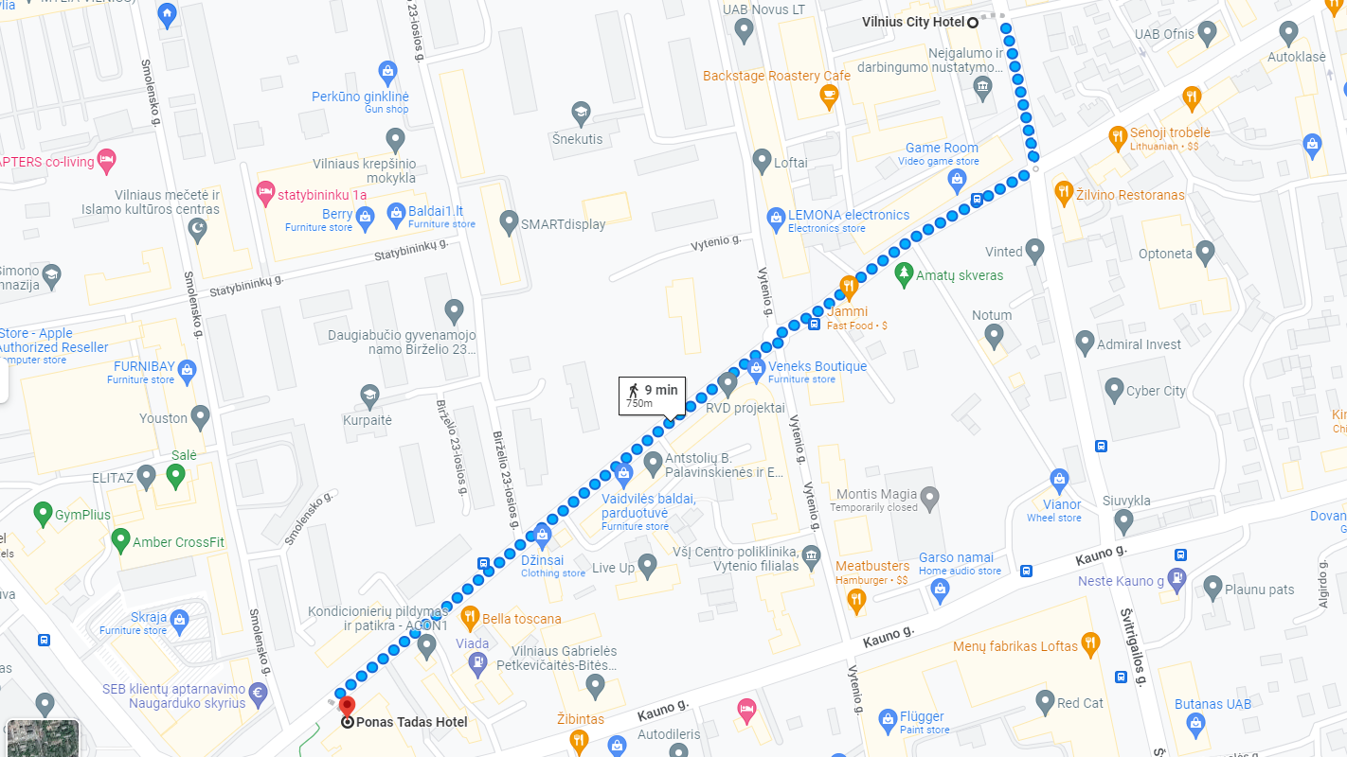
Vilnius City Hotel
Adress: Švitrigailos g. 11D, Naujamiestis, LT-03228 Vilnius, Lithuania
Website: https://www.vilniuscityhotel.com/

Slide 6
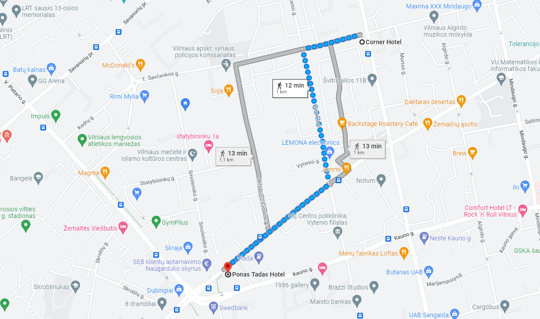
Corner Hotel
Adress: T. Ševčenkos g. 16, Naujamiestis, LT-03111 Vilnius, Lithuania
Website: https://cornerhotel.lt/?lang=en

Slide 7
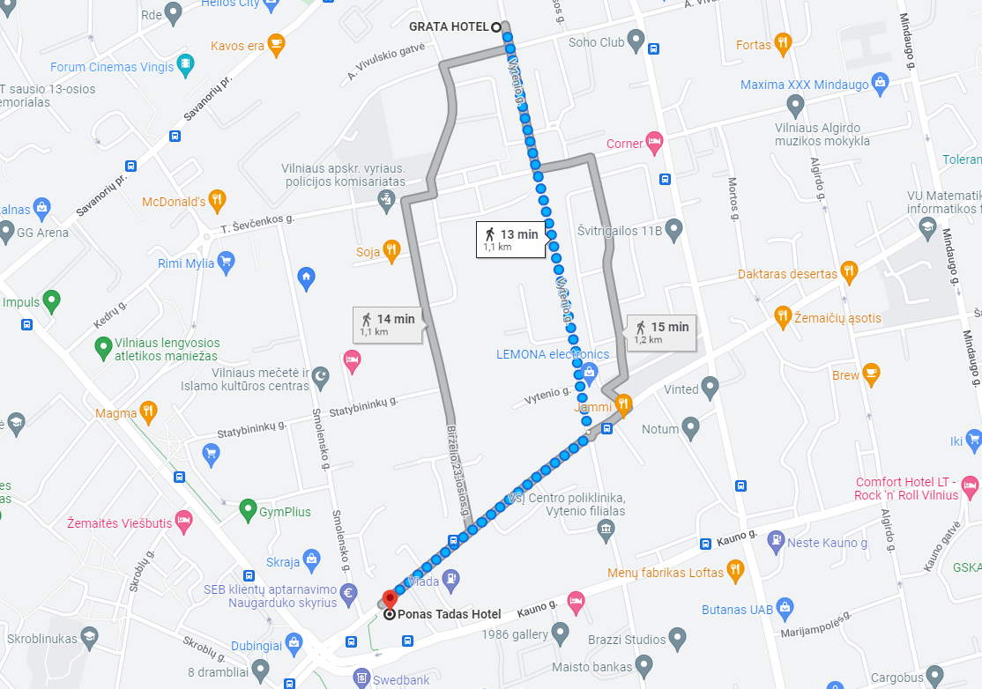
Grata by Centrum Hotels
Adress: Vytenio g. 9, Naujamiestis, LT-03113 Vilnius, Lithuania
Website: https://www.gratahotel.com/

Slide 8
Problems?
Contact straith to Gintare Norvile
Email – lithuanianopen@gmail.com
Phone and WhatsApp - +37064815363
Facebook Messenger – Gintare Norvile
See you in Vilnius!

